Slide 1
Julia in Production A personal journey
Home
Avik Sengupta
JuliaCon 2014
Notes:
Discuss our experiences using Julia in the commercial industry. Purely personal experience. Stream of consciousness.

Slide 2
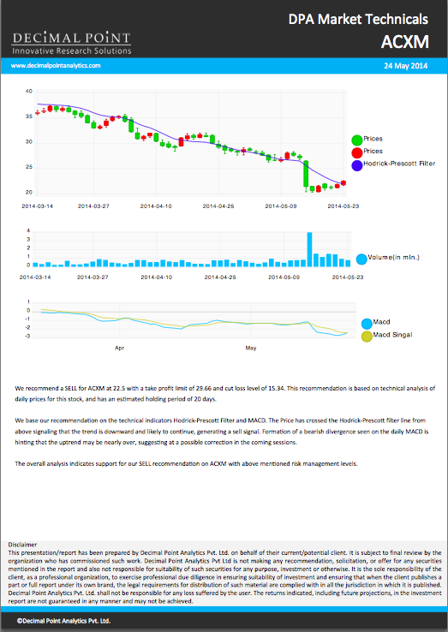
Notes:
Create technical analysis reports for equity and foreign exchange markets.

Slide 3
Why Julia
Why Not?
Core technical analysis algorithms written in Julia
Notes:
We wanted the ability to code upto a 100 indicators quickly. And then run them through thousands of stocks quickly. Eventually we want to do it intra day, so speed is off the essence. We also wanted the models built by our quant to be used directly in production, rather than having to re-write them from MATLAB.

Slide 4
3 Developers
Remote team
3-4 months
Notes:
Teaching julia was relatively easy. One Java developer. One MATLAB quant. Teaching proper programming practices to quant was more difficult than teaching julia syntax to java programmer.

Slide 5
Packages
ODBC
Decision Tree
Gadfly
Call out to Java for Natural Language Generation, PDF Generation
Notes:
Jacob, Ben, Daniel

Slide 6
Stable, nightly or source?
Notes:
The most important decision in using Julia in 2014. I am involved in Julia development, but the rest of the team is not. We decided to stick with 0.2 for a while, but eventually moved to a 0.3 snapshot. But don’t upgrade daily. Or even often.

Slide 7
Packages – to upgrade or not to upgrade
Package backward compatibility
Travis / pkg.julialang.org
Notes:
Stats renmaing

Slide 8
PLEASE support last released julia version for all packages

Slide 9
There will be bugs

Slide 10
Minimal Test Cases

Slide 11
Deployment – Custom AWS image with Julia and packages.
Code deployed via git
Notes:
This works for hosted systems, but..

Slide 12
Bundler for Julia?
Notes:
Some way to bundle packages and custom code together. Bundler is controversial in ruby land.

Slide 13
Cron
Notes:
Julia is stable. No stability issues discovered. But cannot bet on it. So use cron to manage process lifecycle. KISS. Should probably check out god/monit etc.

Slide 14
Publication quality charts?
Notes:
So this may be controversial… Default aesthetics for many R and matlab charting tools are for academic publications, very dense. Charts in financial reports need to be much more information light. This usually takes a lot of work in tweaking the look and feel. Thankfully, the default aesthetics of Gadfly charts are very good for our use.

Slide 15
Logging
kmsquire/Logging.jl
forio/Lumberjack.jl

Slide 16
And finally
Not as risky as it sounds
But need to keep your eyes open

